Slide 1

Monitoring of Environment
during Major Events
Monitoring of Environment
during Major Events
LADISLAVA NAVRATILOVA
Population Protection Institute
General Directorate of Fire and Rescue Service
Czech Republic
ladislava.navratilova@ioolb.izscr.cz
Qatar 2018

Slide 2
Outline
OUTLINE
Population Protection Institute (PPI)
Major event preparation
Monitoring equipment
Experiment / influence of HVAC system
Lessons learned
Conclusion

Slide 3

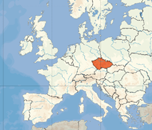
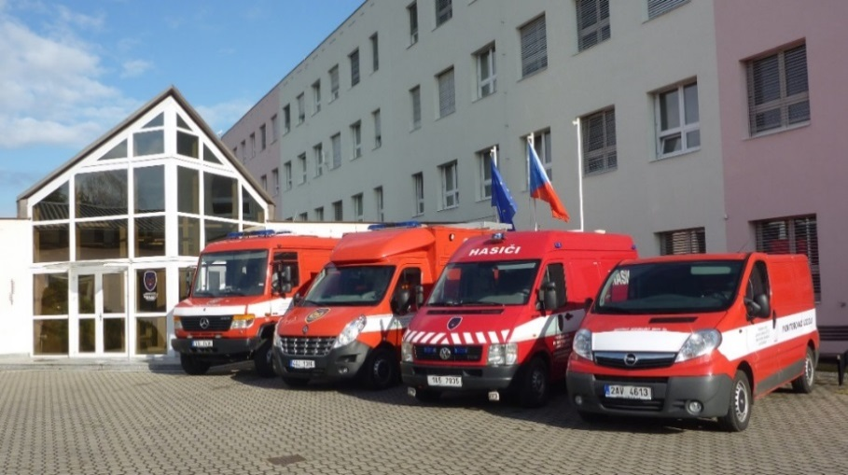
Population Protection Institute
Ministry of the Interior
General Directorate
Fire & Rescue Service of the Czech Republic
Activities
HazMat response in case of CBRN emergency
Education: national + international trainings (OPCW, NATO)
Scientific research

Slide 4
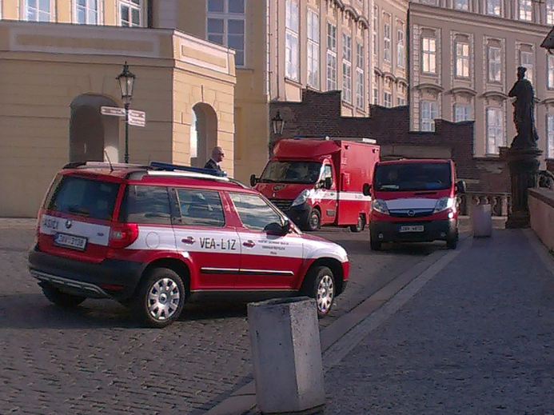
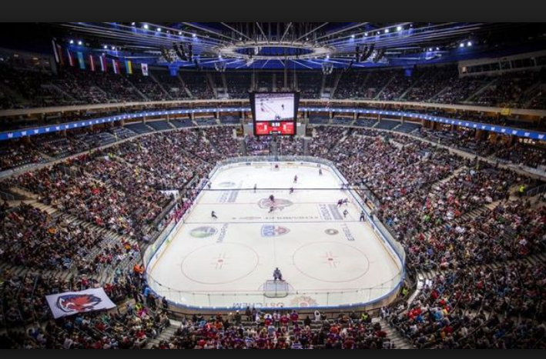
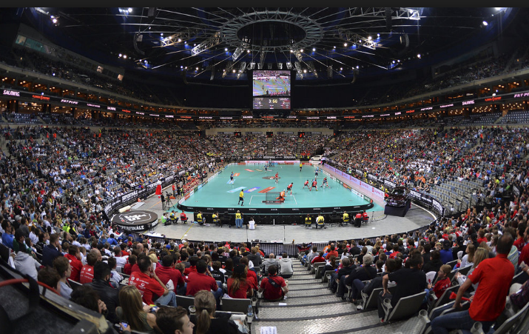
Major events in Czech Republic
Monitoring
Visits of important guests in Prague
- monitoring outside
World Ice Hockey Championship 2015
- monitoring inside
EU Figure Skating Championship 2017
- monitoring inside

Slide 5
Security of important events
Preparation phase
Command of GD FRS CR = Plan and Proceeding for Event
specification of tasks and responsibilities
  characteristic of situation
    possibility of special emergency situations
      what – if chemical terrorist attack = legal regulations will be applied
  tasks and activities of involved IRS bodies
    „Population Protection Institute“ responsible for monitoring
    additional „CBRN Analytical Task Forces“ responsible for detection
Joint Standard Operating Procedures
Dirty bomb
Reaction on chemical attack in Prague metro
etc.

Slide 6
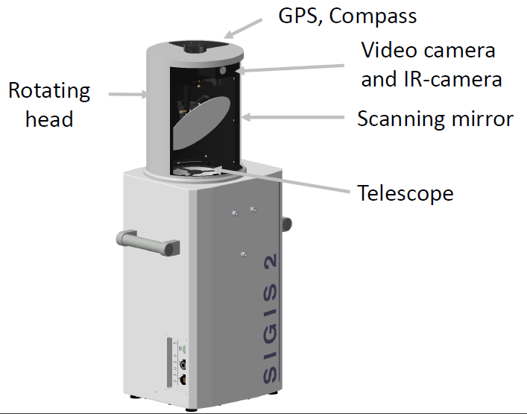
Monitoring equipment
REMOTE SENSING SYSTEM SIGIS 2
(Scanning Infrared Gas Imaging System)
FTIR spectrometer
passive method: no artificial radiation source
principle corresponds to human eye
library of chemicals
Identification, quantification, visualisation of gas cloud from long distances
Combination of videocamera and IR-camera
FTIR spectrum for every point
360°surveillance
real time analysis

Slide 7
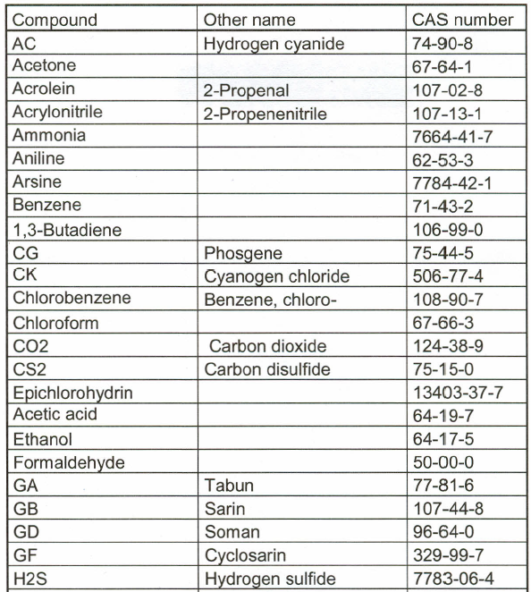
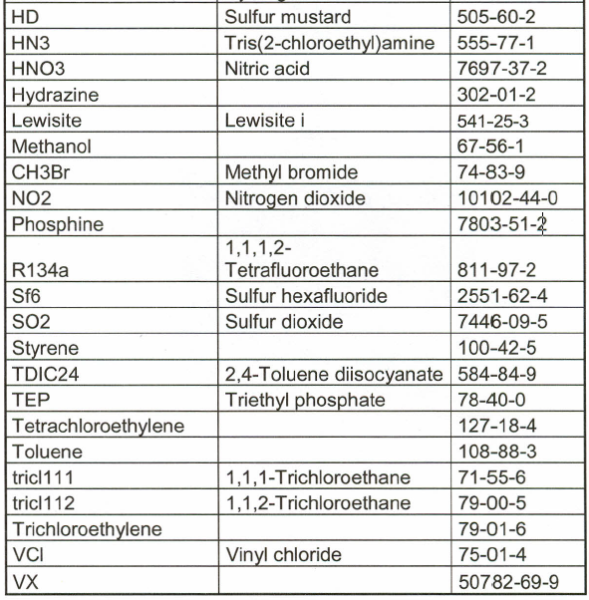
SIGIS 2 – SPECTRAL LIBRARY
unknown
= if a chemical with specific FTIR spectrum is identified and substance is not in library

Slide 8
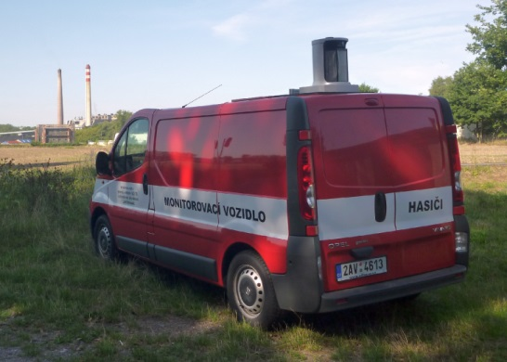
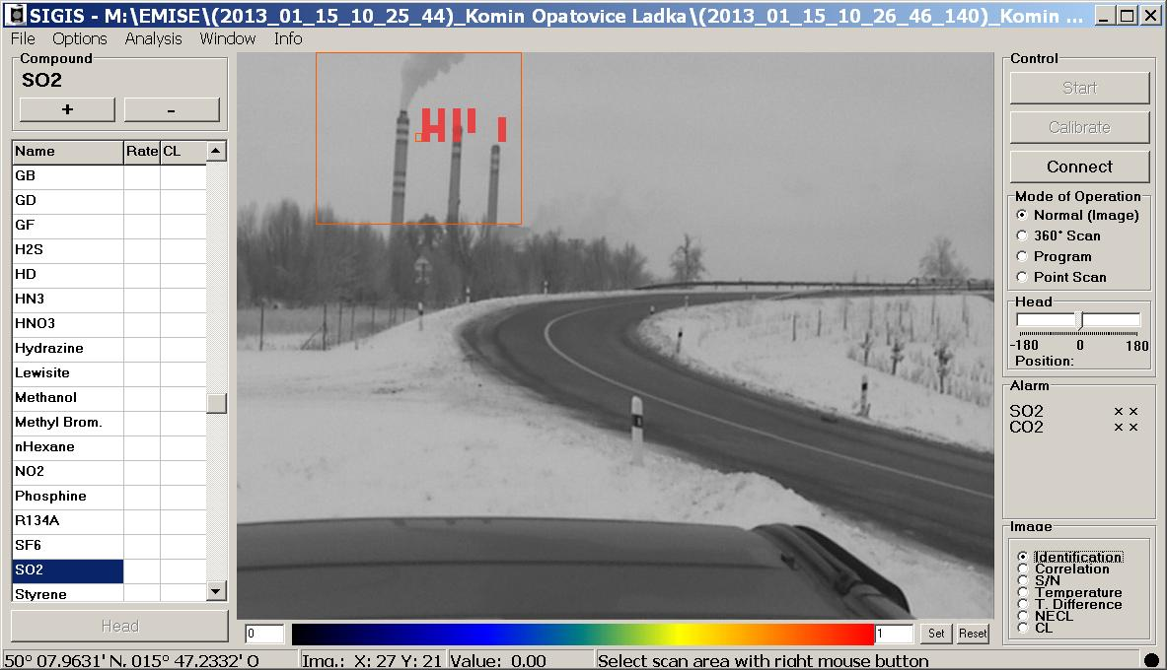
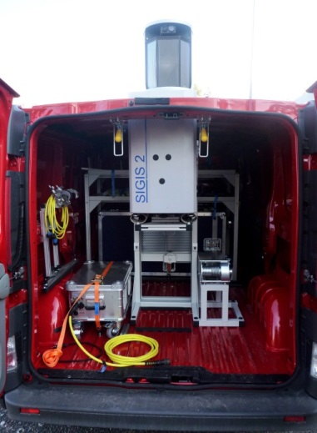
SIGIS 2 - Monitoring outside
EXAMPLE OF MONITORING / OUTSIDE
CO2 leakage from powerpant
acetone explosion

Slide 9
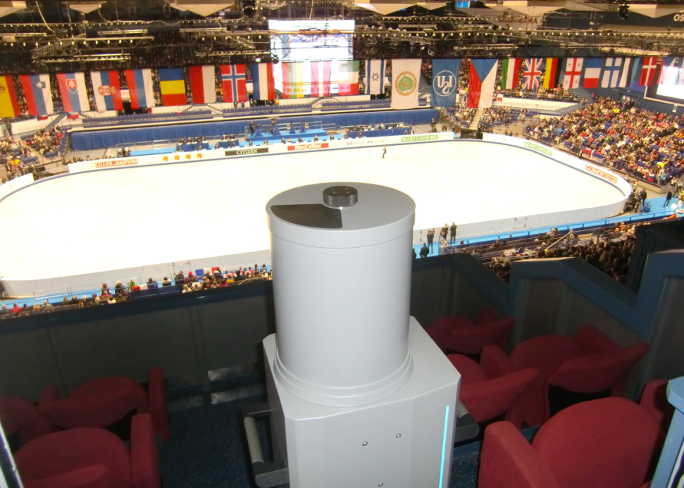
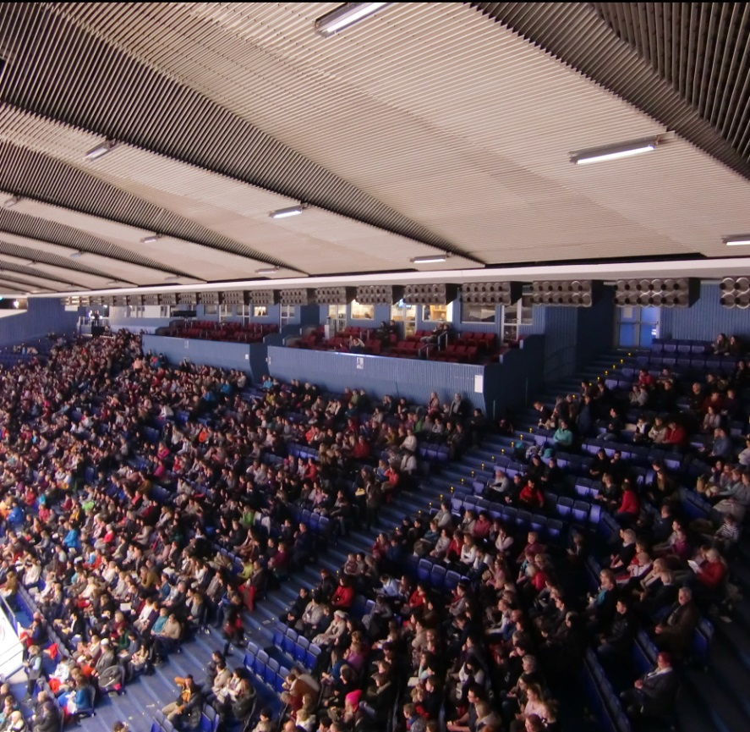
SIGIS 2 - Monitoring inside
REMOTE SENSING SYSTEM SIGIS 2
(EU Figure Scating Championship 2017)
principle corresponds to human eye

Slide 10
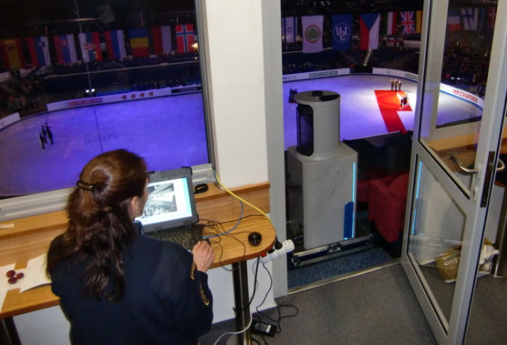
SIGIS 2 - Monitoring inside
MONITORING INSIDE
needs special preparation
  proper location for spectrometer is needful
    the best view
      corresponds to human eye
      the most attendants and VIP zone should be visible
    at the top of building (the highest seating area / under roof)
    necessity to lift and positioned heavy spectrometer
    stable position
    enough space (device + notebook)
    access of electricity
    possibility to lock a device
    staff: 2 experts optimal
    cooling plate for notebook (continuous measurement)

Slide 11
SIGIS 2 - Monitoring inside
ADDITIONAL TOOLS for OPERATORS (monitoring staff)
database of toxic chemicals
  with toxicological information and health effects
binoculars
  to evaluate symptoms of identified chemical
transmitters
  operators must be constantly in connection with officer in charge
protective mask + filter

Slide 12

SIGIS 2 - Monitoring inside
MONITORING PROCESS
monitoring angle 180°/ six steps for 30°
whole process takes approx. 30 - 40 mins

Slide 13
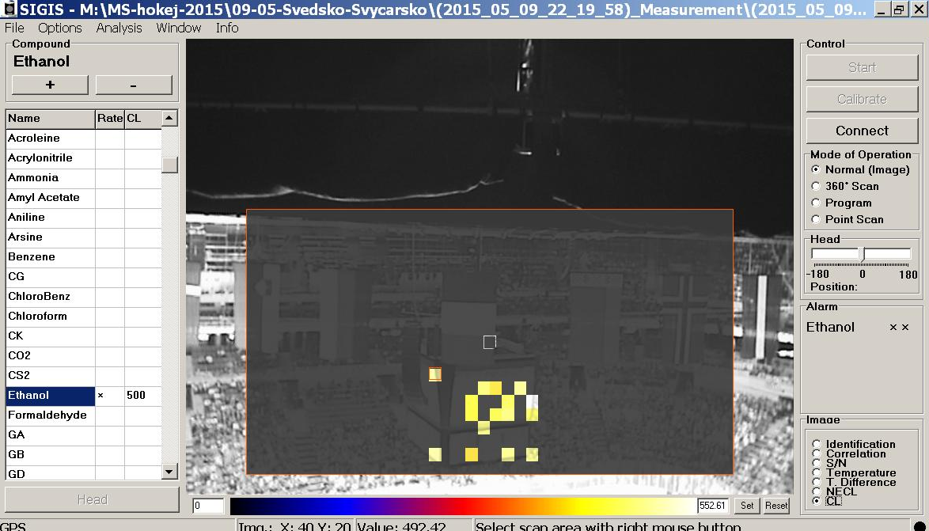
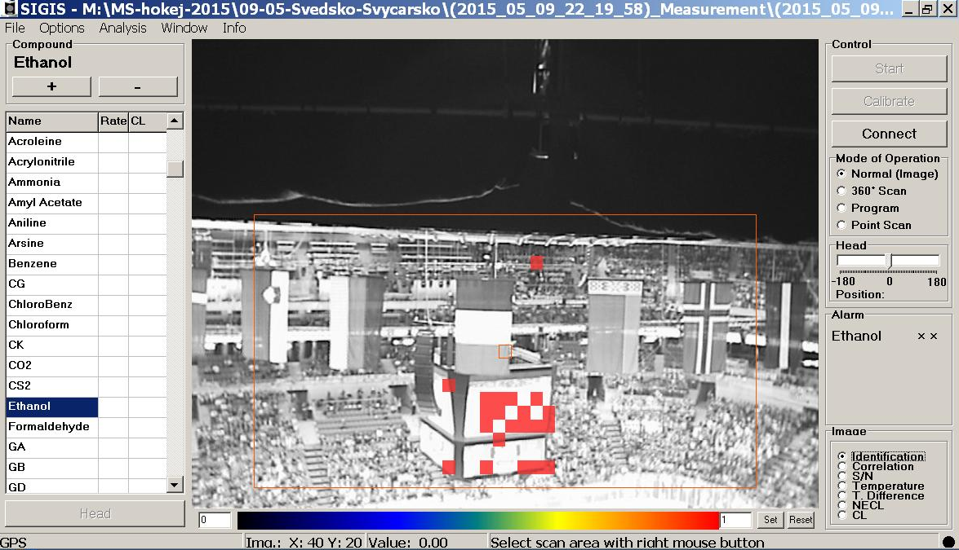
SIGIS 2 - Monitoring inside

Slide 14
SIGIS 2 - Monitoring inside

Slide 15
Response phase
IF SPECIFIC TOXIC CHEMICAL IS IDENTIFIED
RESULT CONFIRMATION AND FAST RESPONSE IS CRUCIAL
using binoculars / observing symptoms
  if symptoms are visible – need to compare real symptoms to symptoms written in a database
briefing officer in charge
dispatching other analytical task force (ATF) to hotspot
  ATF staff is constantly prepared to respond with detection equipment (PID detectors, IMS detectors, detection tubes etc.) to confirm result, to také samples etc.
  ATF staff will be protected in PPE

Slide 16
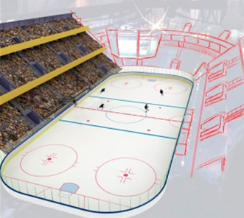
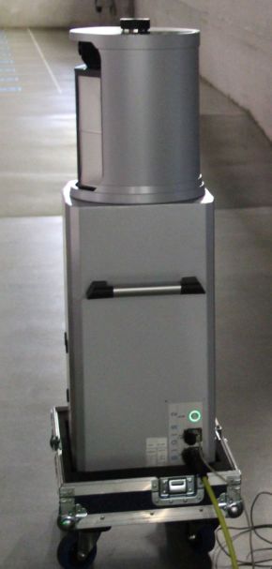
EXPERIMENT – HVAC and chemical release
SIGIS used for monitoring in Ice Hockey Arena
Experimental conditions / chemical release in air-conditioned arena
amyl acetate AAC (substitute for sarin)
dispersed with compressed N2
monitoring with SIGIS
1. indoor release = inside building
2. outdoor release = into HVAC intake unit on roof

Slide 17
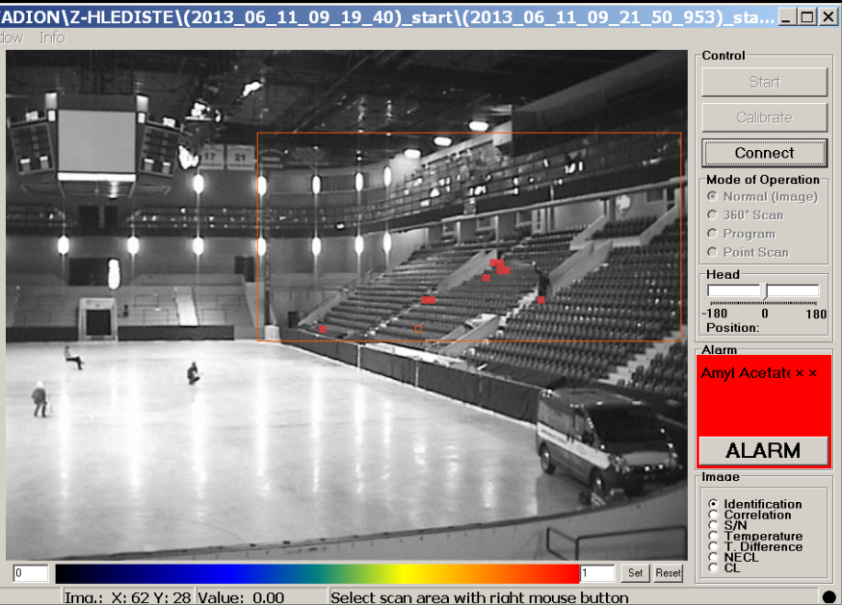
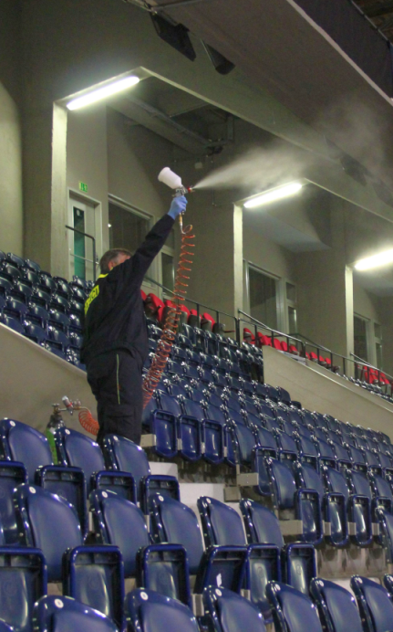
2. INDOOR RELEASE
where the most attendants will be located

Slide 18
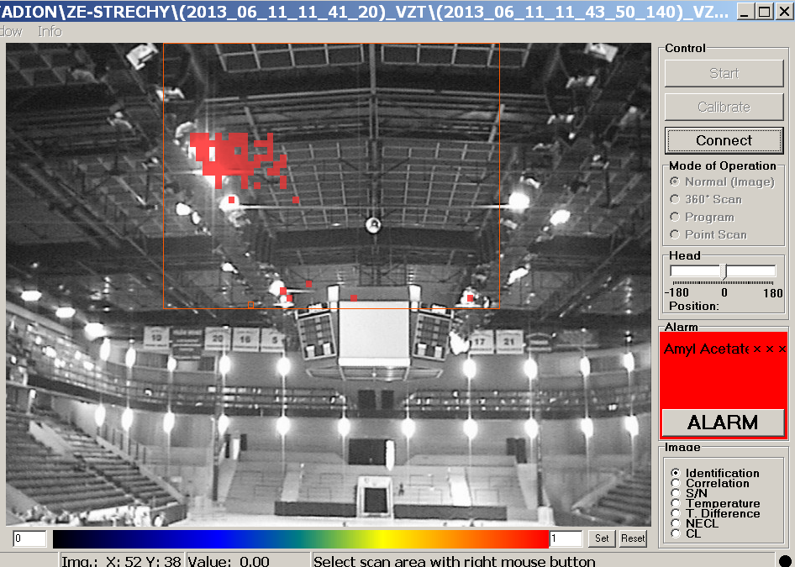
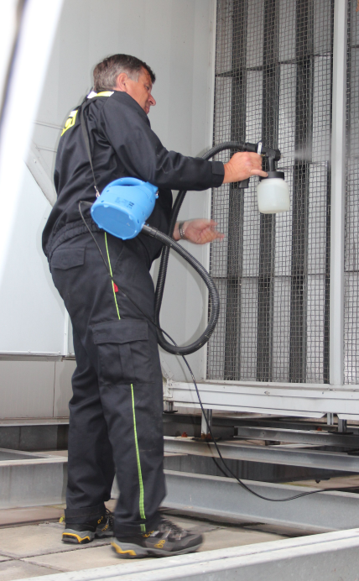
1. OUTDOOR RELEASE
into HVAC unit in a roof

Slide 19
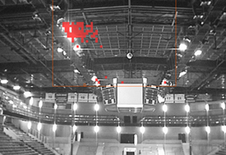
EXPERIMENT
LESSONS LEARNED
Lessons learned
HVAC system is the most important factor for dispersion
Chemical agent is expanded using HVAC in minutes
Start emergency ventilation asap
You must be sure that HVAC system is not contaminated
Building / HVAC system must be secured
(CCTV, guarding, entrance on the roof has to be locked …)
WHEN IT IS NOT CONFIRMED WHERE THE CONTAMINANT IS, IT IS RISKY TO DISTRIBUTE „FRESH“ AIR FROM ROOF INTO BUILDING USING HVAC SYSTEM

Slide 20
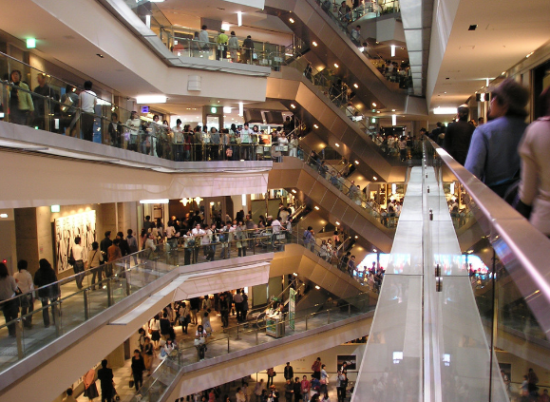
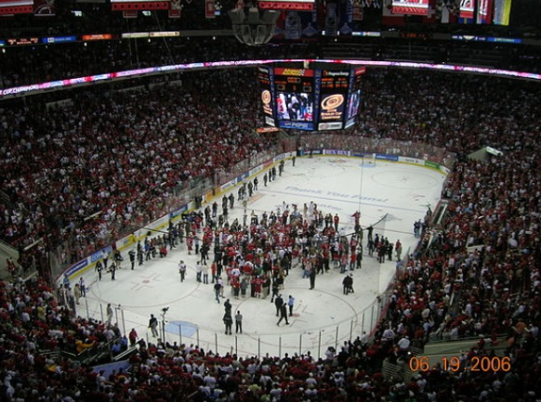
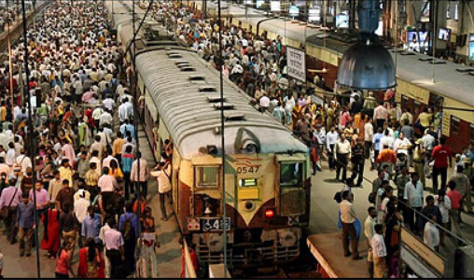
CONCLUSION
PROTECTING LIVES AND SAFEGUARDING PUBLIC BUILDINGS
IN CASE OF CHEMICAL RELEASE
Monitoring of environment is very important
Be familiar with HVAC system in specific public building
Be sure where the source of contamination is before you start to respond
Be familiar with current scientific facts = study external sources
http://securebuildings.lbl.gov
http://www.epa.gov/iaq/largebldgs/baq_page.htm
http://www.cdc.gov/niosh/docs/2002-139/

